Slide 1
Temperature 1 Self-Assembly:
Deterministic Assembly in 3D and Probabilistic Assembly in 2D
SODA
January 23, 2011
Matthew Cook University of Zurich and ETH Zurich
Yunhui Fu Clemson University
Robert Schweller University of Texas Pan American

Slide 2
Outline
Background Information
Model
Results

Slide 3
Molecular Building Blocks
T G C G
A C G C

Slide 4
Molecular Building Blocks
[Reif’s Group, Duke University]

Slide 5
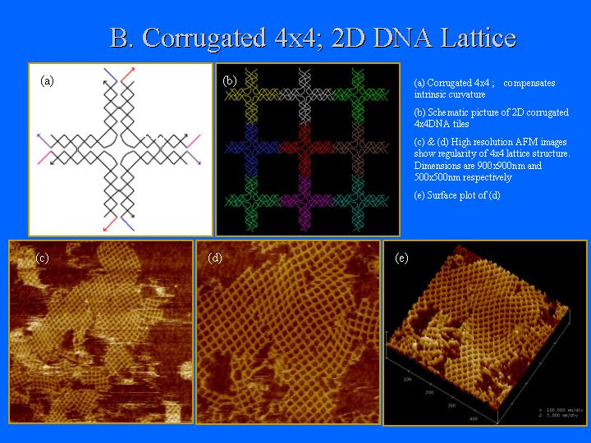
DNA Scaffolding
[Sung Ha Park, Constantin Pistol, Sang Jung Ahn, John H. Reif, Alvin R. Lebeck, Chris Dwyer, and Thomas H. LaBean, 2006]

Slide 6
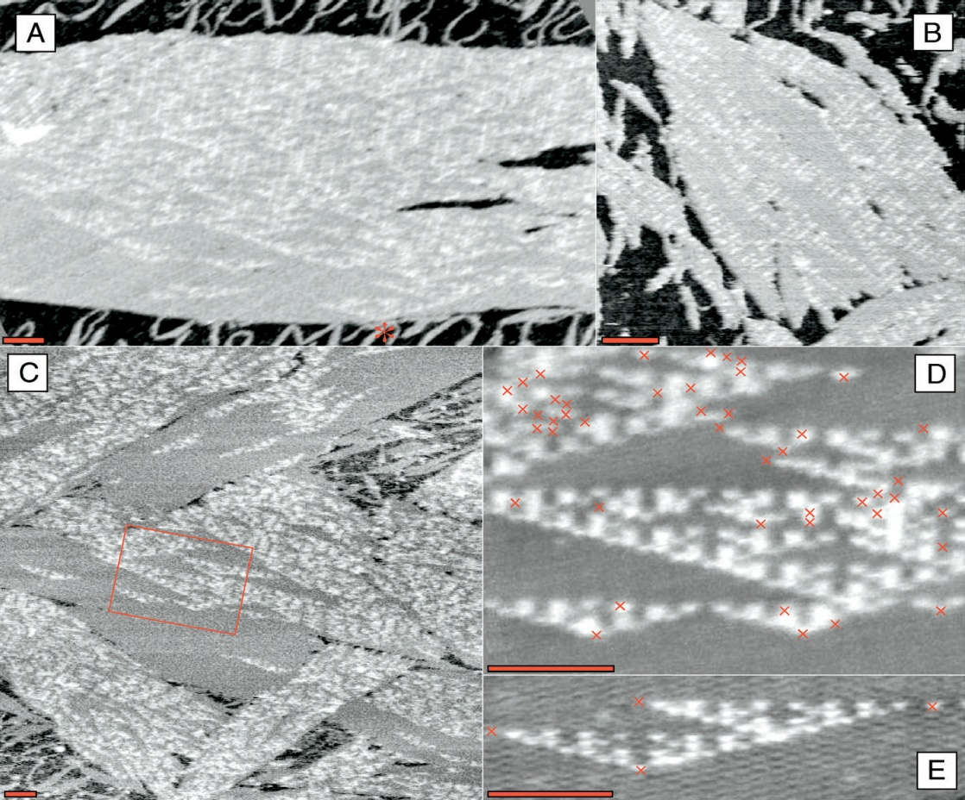
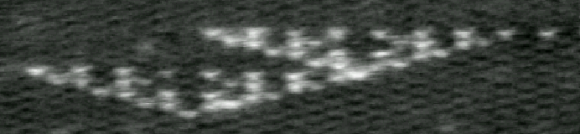
Simulation of Cellular Automata
Paul Rothemund, Nick Papadakis, Erik Winfree, PLoS Biology 2: e424 (2004)
340nm

Slide 7
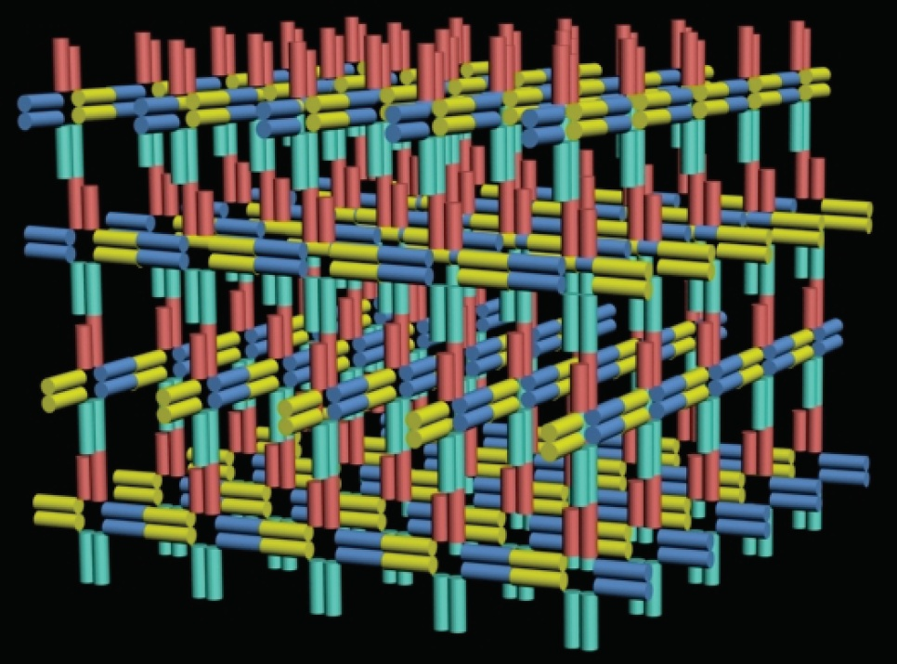
Example of 3D Self-Assembly
[Shaw, University of Southern California]

Slide 8
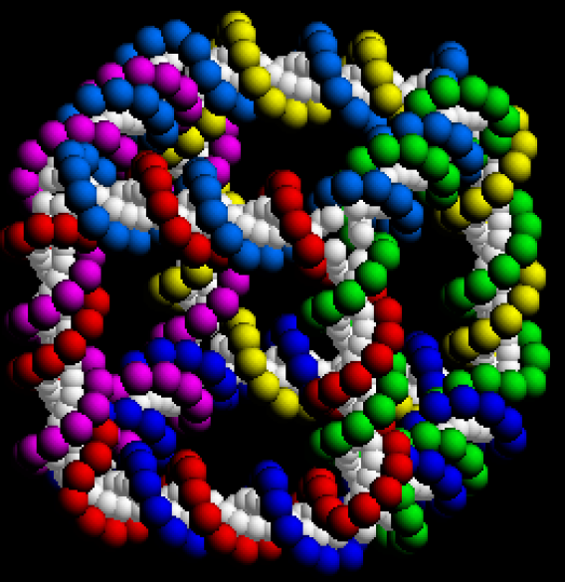
3D DNA Cube
[Seeman, New York University]

Slide 9
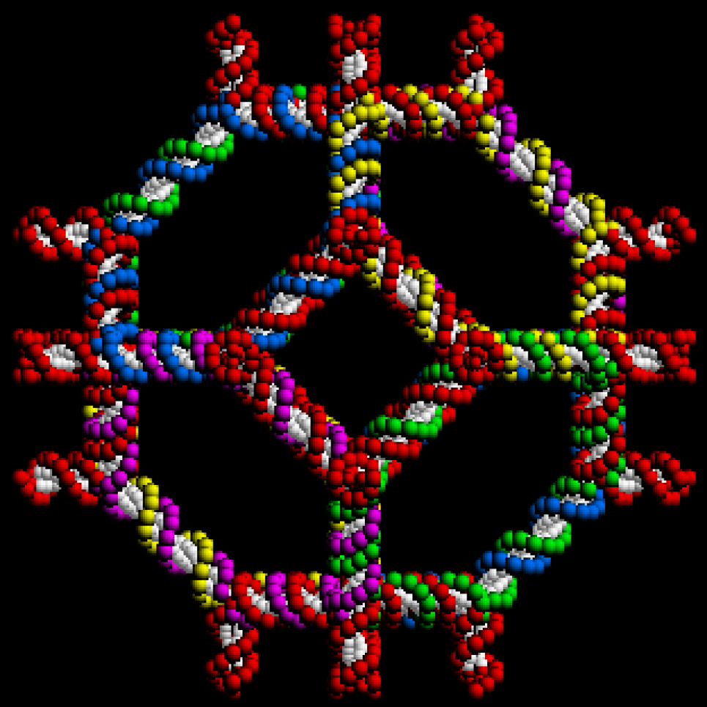
3D DNA Truncated Octahedron
[Seeman, New York University]

Slide 10
Outline
Background Information
Model
Results

Slide 11
Tile Assembly Model
(Rothemund, Winfree, Adleman)
G(y) = 2
G(g) = 2
G(r) = 2
G(b) = 2
G(p) = 1
G(w) = 1
t = 2
T =
Glue
Function:
Tile Set:
Temperature:
Seed Tile:

Slide 12
How a tile system self assembles
G(y) = 2
G(g) = 2
G(r) = 2
G(b) = 2
G(p) = 1
G(w) = 1
t = 2
T =

Slide 13
How a tile system self assembles
G(y) = 2
G(g) = 2
G(r) = 2
G(b) = 2
G(p) = 1
G(w) = 1
t = 2
T =

Slide 14
How a tile system self assembles
G(y) = 2
G(g) = 2
G(r) = 2
G(b) = 2
G(p) = 1
G(w) = 1
t = 2
T =

Slide 15
How a tile system self assembles
G(y) = 2
G(g) = 2
G(r) = 2
G(b) = 2
G(p) = 1
G(w) = 1
t = 2
T =

Slide 16
How a tile system self assembles
G(y) = 2
G(g) = 2
G(r) = 2
G(b) = 2
G(p) = 1
G(w) = 1
t = 2
T =

Slide 17
How a tile system self assembles
G(y) = 2
G(g) = 2
G(r) = 2
G(b) = 2
G(p) = 1
G(w) = 1
t = 2
T =

Slide 18
How a tile system self assembles
G(y) = 2
G(g) = 2
G(r) = 2
G(b) = 2
G(p) = 1
G(w) = 1
t = 2
T =

Slide 19
How a tile system self assembles
G(y) = 2
G(g) = 2
G(r) = 2
G(b) = 2
G(p) = 1
G(w) = 1
t = 2
T =

Slide 20
How a tile system self assembles
G(y) = 2
G(g) = 2
G(r) = 2
G(b) = 2
G(p) = 1
G(w) = 1
t = 2
T =

Slide 21
How efficiently can you build an n x n square?
n

Slide 22
How efficiently can you build an n x n square?
Tile Complexity:
2n
n
x

Slide 23
How efficiently can you build an n x n square?
-Use log n tile types to seed
counter:
0
0
0
0
log n

Slide 24
How efficiently can you build an n x n square?
-Use log n tile types capable of
Binary counting:
-Use 8 additional tile types
capable of binary counting:
0
0
0
0
log n

Slide 25
How efficiently can you build an n x n square?
-Use log n tile types capable of
Binary counting:
-Use 8 additional tile types
capable of binary counting:
1
1
0
0
1
0
0
0
0
1
1
1
0
1
1
0
0
1
0
1
0
1
0
0
0
0
1
1
0
0
1
0
0
0
0
1
0
0
0
0
log n

Slide 26
How efficiently can you build an n x n square?
-Use log n tile types capable of
Binary counting:
1
1
1
1
-Use 8 additional tile types
capable of binary counting:
1
1
1
0
1
1
0
1
1
1
0
0
1
0
1
1
1
0
1
0
1
0
0
1
1
0
0
0
0
1
1
1
0
1
1
0
0
1
0
1
0
1
0
0
0
0
1
1
0
0
1
0
0
0
0
1
0
0
0
0
log n

Slide 27
How efficiently can you build an n x n square?
-Use log n tile types capable of
Binary counting:
1
1
1
1
-Use 8 additional tile types
capable of binary counting:
1
1
1
0
1
1
0
1
1
1
0
0
1
0
1
1
1
0
1
0
1
0
0
1
1
0
0
0
0
1
1
1
0
1
1
0
0
1
0
1
0
1
0
0
0
0
1
1
0
0
1
0
0
0
0
1
0
0
0
0
0
0
0
0
0
0
0
0
1
1
1
1
1
1
1
1
0
0
0
0
1
1
1
1
0
0
0
0
1
1
1
1
0
0
1
1
0
0
1
1
0
0
1
1
0
0
1
1
0
1
0
1
0
1
0
1
0
1
0
1
0
1
0
1

Slide 28
How efficiently can you build an n x n square?
1
1
1
1
Tile Complexity:
O(log n)
1
1
1
0
1
1
0
1
1
1
0
0
(Rothemund, Winfree 2000)
1
0
1
1
n – log n
1
0
1
0
1
0
0
1
1
0
0
0
0
1
1
1
0
1
1
0
0
1
0
1
x
0
1
0
0
0
0
1
1
0
0
1
0
0
0
0
1
0
0
0
0
0
0
0
0
0
0
0
0
1
1
1
1
1
1
1
1
log n
y
0
0
0
0
1
1
1
1
0
0
0
0
1
1
1
1
0
0
1
1
0
0
1
1
0
0
1
1
0
0
1
1
0
1
0
1
0
1
0
1
0
1
0
1
0
1
0
1

Slide 29
How efficiently can you build an n x n square?
1
1
1
1
Tile Complexity:
O(log n)
1
1
1
0
1
1
0
1
1
1
0
0
(Rothemund, Winfree 2000)
1
0
1
1
n – log n
1
0
1
0
1
0
0
1
With optimal
counter:
Tile Complexity:
O(log n / loglog n)
1
0
0
0
0
1
1
1
0
1
1
0
0
1
0
1
x
0
1
0
0
(Adleman, Cheng, Goel,
Huang 2001)
0
0
1
1
0
0
1
0
0
0
0
1
Meets lower
bound:
Ω(log n / loglog n)
0
0
0
0
0
0
0
0
0
0
0
0
1
1
1
1
1
1
1
1
log n
y
0
0
0
0
1
1
1
1
0
0
0
0
1
1
1
1
0
0
1
1
0
0
1
1
0
0
1
1
0
0
1
1
(Rothemund, Winfree 2000)
0
1
0
1
0
1
0
1
0
1
0
1
0
1
0
1

Slide 30
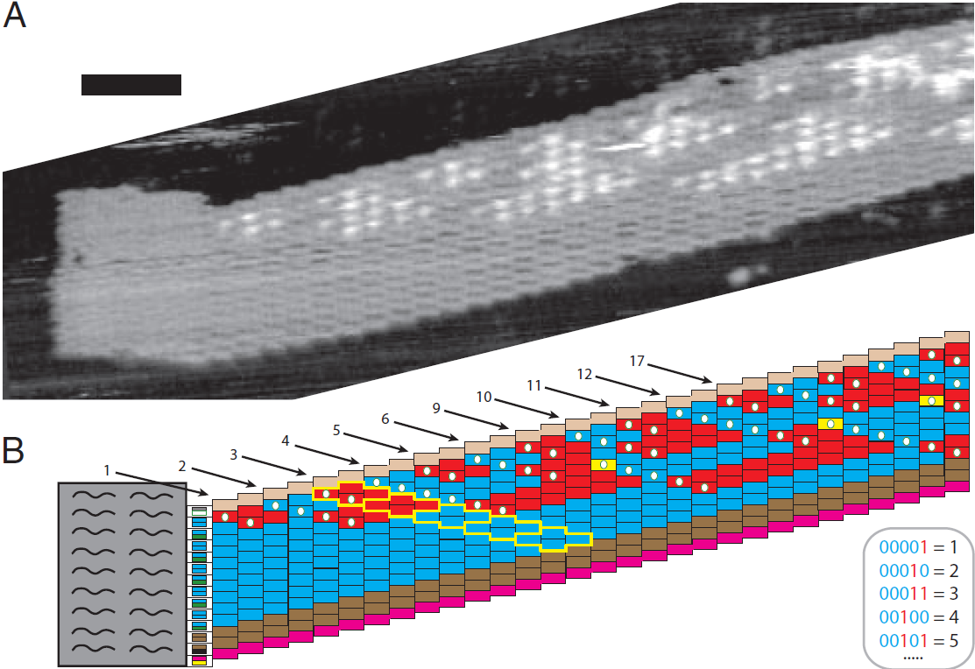
Barish, Shulman, Rothemund, Winfree, 2009

Slide 31
Why is Temperature 1 Theory Important?
Temperature 2 self-assembly is powerful
  Efficient assembly of squares and more general shapes
  Universal Computation
But….
  Precise laboratory settings required
  High error rates
y
x

Slide 32
Why is Temperature 1 Theory Important?
Temperature 2 self-assembly is powerful
  Efficient assembly of squares and more general shapes
  Universal Computation
But….
  Precise laboratory settings required
  High error rates
y
x

Slide 33
Why is Temperature 1 Theory Important?
Temperature 2 self-assembly is powerful
  Efficient assembly of squares and more general shapes
  Universal Computation
But….
  Precise laboratory settings required
  High error rates
Error locked in place

Slide 34
Why is Temperature 1 Theory Important?
Temperature 2 self-assembly is powerful
  Efficient assembly of squares and more general shapes
  Universal Computation
But….
  Precise laboratory settings required
  High error rates
Error locked in place
Question:
Is temperature 1 substantially less powerful than temperature 2?
Is temperature 1 powerful enough to warrant consideration considering it’s potential experimental advantages?

Slide 35
Build an n x n square at Temperature 1
s
a1

Slide 36
Build an n x n square at Temperature 1
s
A1
A2
A3
A4
A5
a1
a2
a3
a4
a5

Slide 37
Build an n x n square at Temperature 1
B5
b1
B4
b1
B3
b1
B2
b1
B1
b1
b1
b1
b1
b1
b1
b1
s
A1
A2
A3
A4
A5
a1
a2
a3
a4
a5

Slide 38
Build an n x n square at Temperature 1
B5
B5
B5
B5
B5
B5
B4
B4
B4
B4
B4
B4
B3
B3
B3
B3
B3
B3
B2
B2
B2
B2
B2
B2
B1
B1
B1
B1
B1
B1
s
A1
A2
A3
A4
A5

Slide 39
Build an n x n square at Temperature 1
Distinct tile types:
2n-1
Probably optimal, but no
substantial lower bound
proof has been given.
B5
B5
B5
B5
B5
B5
B4
B4
B4
B4
B4
B4
B3
B3
B3
B3
B3
B3
B2
B2
B2
B2
B2
B2
B1
B1
B1
B1
B1
B1
s
A1
A2
A3
A4
A5

Slide 40
Build an n x n square at Temperature 1
Distinct tile types:
2n-1
Probably optimal, but no
substantial lower bound
proof has been given.
Two directions to consider
Can we do better if consider 3D assembly? (3D deterministic assembly)
Can we do better if we permit a small chance of error? (2D probabilistic assembly)
B5
B5
B5
B5
B5
B5
B4
B4
B4
B4
B4
B4
B3
B3
B3
B3
B3
B3
B2
B2
B2
B2
B2
B2
B1
B1
B1
B1
B1
B1
s
A1
A2
A3
A4
A5

Slide 41
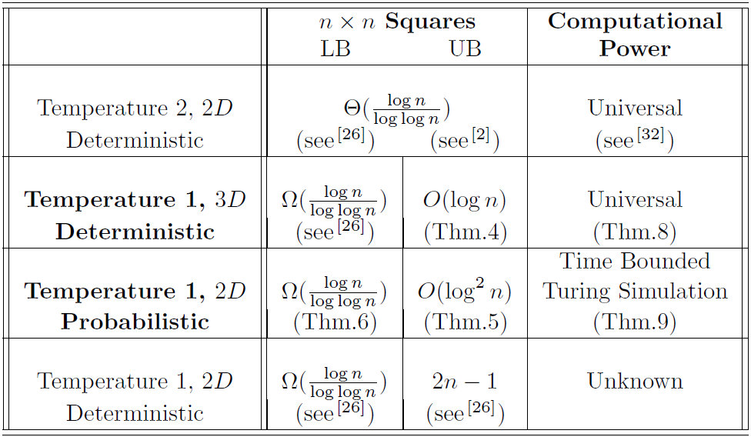
Our Temperature 1 Results

Slide 42
Outline
Background Information
Model
Results
  Temperature 1 in 3D
  Temperature 1 in 2D, probabilistic

Slide 43
Simulating Temp 2 Systems at Temp 1
0
1
x
0
x
x
1
x
0
1
1
0
x
1
c
c
0
c
0
1
c
0
*
0
0
1
*
0
0
1
1
*
0
0
1
0
*
0
0
0
1
*
0
0
0
0
0

Slide 44
Simulating Temp 2 Systems at Temp 1
0
1
x
0
x
x
1
x
0
1
1
0
x
1
c
c
0
c
0
1
0
c
0
c
1
c
0
*
0
0
1
*
0
0
1
1
*
0
0
1
0
*
0
0
0
1
*
0
0
0
0
0

Slide 45
Simulating Temp 2 Systems at Temp 1
0
1
x
0
x
x
1
x
0
1
1
0
x
1
c
c
0
c
0
1
0
0
c
0
0
*
0
0
*
0
0
1
1
*
0
0
1
0
*
0
0
0
1
*
0
0
0
0
0

Slide 46
Simulating Temp 2 Systems at Temp 1
0
1
x
0
x
x
1
x
0
1
1
0
x
1
c
c
0
c
0
1
1
x
1
c
0
0
0
c
0
0
*
0
0
*
0
0
1
1
*
0
0
1
0
*
0
0
0
1
*
0
0
0
0
0

Slide 47
Simulating Temp 2 Systems at Temp 1
0
1
x
0
x
x
1
x
0
1
1
0
x
1
c
c
0
c
0
1
1
0
0
x
1
0
0
*
0
*
0
0
1
1
*
0
0
1
0
*
0
0
0
1
*
0
0
0
0
0

Slide 48
Simulating Temp 2 Systems at Temp 1
Key idea:
Map each single temperature 2 tile to a collection of tiles constituting a “macro” tile
Use 3D geometry to encode north outputs.
2 outputs
B
A
Y
X
2 inputs
(X,Y)

Slide 49
Simulating Temp 2 Systems at Temp 1
Key idea:
Map each single temperature 2 tile to a collection of tiles constituting of a “macro” tile
Use 3D geometry to encode north outputs.
2 outputs
B
A
Y
X
2 inputs
(X,Y)

Slide 50
Simulating Temp 2 Systems at Temp 1
Key idea:
Map each single temperature 2 tile to a collection of tiles constituting a “macro” tile
Use 3D geometry to encode north outputs.
2 outputs
B
A
Y
X
2 inputs
(X,Y)

Slide 51
Simulating Temp 2 Systems at Temp 1
Key idea:
Map each single temperature 2 tile to a collection of tiles constituting a “macro” tile
Use 3D geometry to encode north outputs.
2 outputs
B
A
Y
X
2 inputs
(X,Y)

Slide 52
Simulating Temp 2 Systems at Temp 1
Key idea:
Map each single temperature 2 tile to a collection of tiles constituting a “macro” tile
Use 3D geometry to encode north outputs.
2 outputs
B
A
Y
X
2 inputs
(X,Y)

Slide 53
Simulating Temp 2 Systems at Temp 1
Key idea:
Map each single temperature 2 tile to a collection of tiles constituting a “macro” tile
Use 3D geometry to encode north outputs.
2 outputs
B
A
Y
X
2 inputs
(X,Y)

Slide 54
Simulating Temp 2 Systems at Temp 1
Key idea:
Map each single temperature 2 tile to a collection of tiles constituting a “macro” tile
Use 3D geometry to encode north outputs.
2 outputs
B
A
Y
X
2 inputs
(X,Y)

Slide 55
Simulating Temp 2 Systems at Temp 1
Key idea:
Map each single temperature 2 tile to a collection of tiles constituting a “macro” tile
Use 3D geometry to encode north outputs.
2 outputs
B
A
Y
X
2 inputs
(X,Y)

Slide 56
Simulating Temp 2 Systems at Temp 1
Key idea:
Map each single temperature 2 tile to a collection of tiles constituting a “macro” tile
Use 3D geometry to encode north outputs.
2 outputs
B
A
Y
X
2 inputs
(X,Y)

Slide 57
Simulating Temp 2 Systems at Temp 1
Key idea:
Map each single temperature 2 tile to a collection of tiles constituting a “macro” tile
Use 3D geometry to encode north outputs.
2 outputs
B
A
Y
X
2 inputs
(X,Y)

Slide 58
Simulating Temp 2 Systems at Temp 1
Key idea:
Map each single temperature 2 tile to a collection of tiles constituting a “macro” tile
Use 3D geometry to encode north outputs.
2 outputs
B
A
Y
X
2 inputs
(X,Y)

Slide 59
Simulating Temp 2 Systems at Temp 1
Key idea:
Map each single temperature 2 tile to a collection of tiles constituting a “macro” tile
Use 3D geometry to encode north outputs.
2 outputs
B
A
Y
X
2 inputs
(X,Y)

Slide 60
Simulating Temp 2 Systems at Temp 1
Key idea:
Map each single temperature 2 tile to a collection of tiles constituting a “macro” tile
Use 3D geometry to encode north outputs.
2 outputs
B
A
Y
X
2 inputs
(X,Y)

Slide 61
Simulating Temp 2 Systems at Temp 1
Key idea:
Map each single temperature 2 tile to a collection of tiles constituting a “macro” tile
Use 3D geometry to encode north outputs.
2 outputs
B
A
Y
X
2 inputs
(X,Y)

Slide 62
Simulating Temp 2 Systems at Temp 1
Key idea:
Map each single temperature 2 tile to a collection of tiles constituting a “macro” tile
Use 3D geometry to encode north outputs.
2 outputs
B
A
Y
X
2 inputs
(X,Y)

Slide 63
Simulating Temp 2 Systems at Temp 1
Key idea:
Map each single temperature 2 tile to a collection of tiles constituting a “macro” tile
Use 3D geometry to encode north outputs.
2 outputs
B
A
Y
X
2 inputs
(X,Y)

Slide 64
Simulating Temp 2 Systems at Temp 1
Key idea:
Map each single temperature 2 tile to a collection of tiles constituting a “macro” tile
Use 3D geometry to encode north outputs.
2 outputs
B
A
Y
X
2 inputs
(X,Y)

Slide 65
Simulating Temp 2 Systems at Temp 1
Key idea:
Map each single temperature 2 tile to a collection of tiles constituting a “macro” tile
Use 3D geometry to encode north outputs.
2 outputs
B
A
Y
X
2 inputs
(X,Y)

Slide 66
Simulating Temp 2 Systems at Temp 1
Key idea:
Map each single temperature 2 tile to a collection of tiles constituting a “macro” tile
Use 3D geometry to encode north outputs.
2 outputs
B
A
Y
X
2 inputs
(X,Y)

Slide 67
Simulating Temp 2 Systems at Temp 1
Key idea:
Map each single temperature 2 tile to a collection of tiles constituting a “macro” tile
Use 3D geometry to encode north outputs.
2 outputs
B
A
Y
X
2 inputs
(X,Y)

Slide 68
Simulating Temp 2 Systems at Temp 1
Key idea:
Map each single temperature 2 tile to a collection of tiles constituting a “macro” tile
Use 3D geometry to encode north outputs.
2 outputs
B
A
Y
X
2 inputs
(X,Y)

Slide 69
Simulating Temp 2 Systems at Temp 1
Key idea:
Map each single temperature 2 tile to a collection of tiles constituting a “macro” tile
Use 3D geometry to encode north outputs.
2 outputs
B
A
Y
X
2 inputs
(X,Y)

Slide 70
Simulating Temp 2 Systems at Temp 1
Key idea:
Map each single temperature 2 tile to a collection of tiles constituting a “macro” tile
Use 3D geometry to encode north outputs.
2 outputs
B
A
Y
X
2 inputs
(X,Y)

Slide 71
Simulating Temp 2 Systems at Temp 1
Key idea:
Map each single temperature 2 tile to a collection of tiles constituting a “macro” tile
Use 3D geometry to encode north outputs.
2 outputs
B
A
Y
X
2 inputs
(X,Y)

Slide 72
Simulating Temp 2 Systems at Temp 1
Key idea:
Map each single temperature 2 tile to a collection of tiles constituting a “macro” tile
Use 3D geometry to encode north outputs.
B
“0”
“1”
2 outputs
B
A
Y
X
2 inputs
A
(X,Y)

Slide 73
Simulating Temp 2 Systems at Temp 1
B
“0”
“1”
B
A
Y
X
Y
X
A
(X,Y)

Slide 74
Simulating Temp 2 Systems at Temp 1
V
B
A
Y
X
V
Y
X
W
W

Slide 75
Simulating Temperature 2 Systems at Temperature 1
B
Geometry decoding tiles:
A
Y
X
V
Y
X
W
Y

Slide 76
Simulating Temp 2 Systems at Temp 1
Y

Slide 77
Simulating Temp 2 Systems at Temp 1
Y

Slide 78
Simulating Temp 2 Systems at Temp 1
Y

Slide 79
Simulating Temp 2 Systems at Temp 1
B
A
Y
X
V
Y
X
W
(X,Y)

Slide 80
Simulating Temp 2 Systems at Temp 1
B
“0”
“1”
B
A
Y
X
V
Y
X
W
A

Slide 81
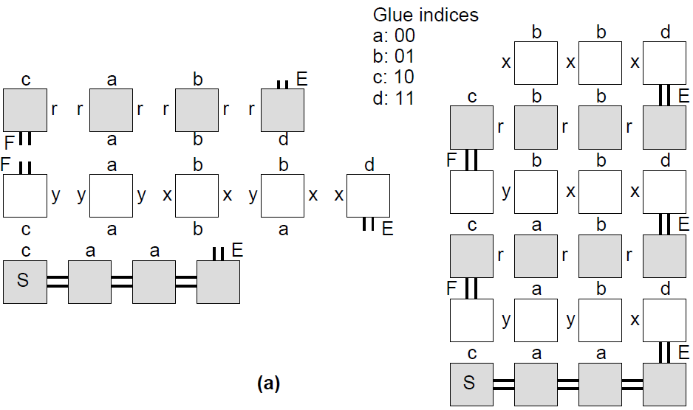

Slide 82
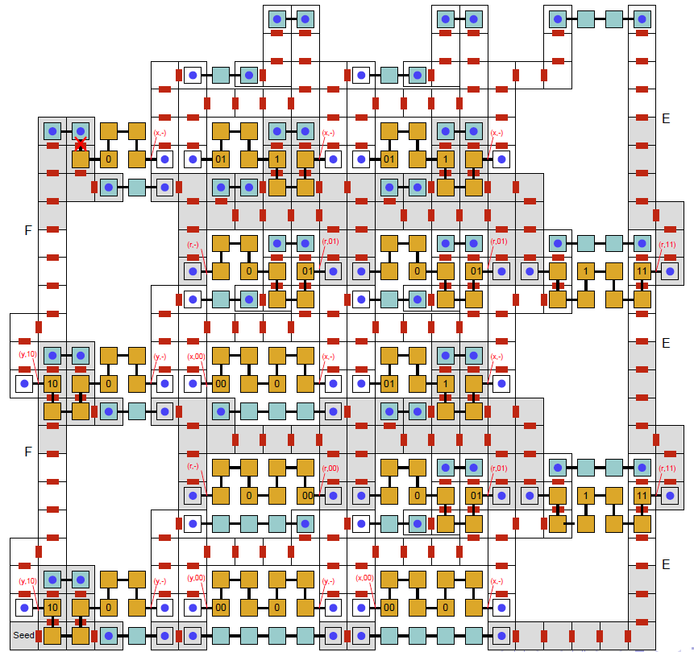

Slide 83
Outline
Background Information
Model
Results
  Temperature 1 in 3D
  Temperature 1 in 2D, probabilistic

Slide 84
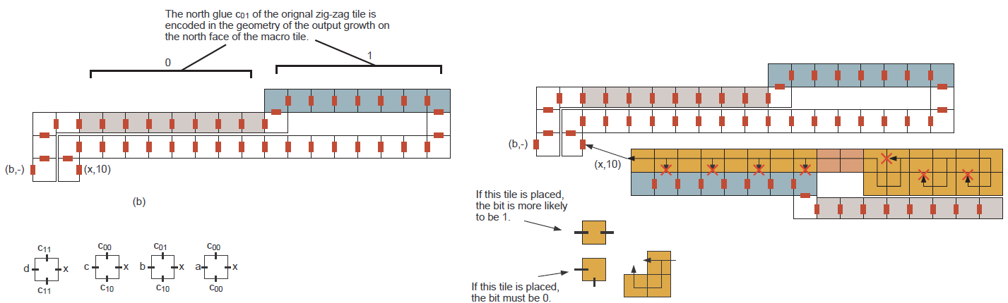
Simulating Temperature 2 Systems at Temperature 1:
2D with high probability

Slide 85
Summary
3D temperature 1 and 2D probabilistic temperature 1 offer much of the power of temperature 2.
Temperature 1 self-assembly may have important experimental motivation.
The use of steric hindrance and steric protection seems inline with nature:
  Steric hindrance is a common mechansim in nature.
  The physical shape of proteins in biology is closely related to function.

Slide 86
Future Work
  Lower bound for nxn squares for temperature 1, 2D, deterministic.
  Multiple nucleation.
  Can the nxn 3D result be improve to O(log n / loglog n)?
  Combine ideas from this work with other techniques for robustness and error correction.
  Improve sturdiness or connectivity of constructions.

