Slide 1
Linear Time Probabilistic Algorithms for the Singular Haplotype Reconstruction Problem from SNP Fragments
The Sixth Asia Pacific Bioinformatics Conference
January 16, 2008
Zhixiang Chen University of Texas Pan American
Bin Fu University of Texas Pan American
Robert Schweller University of Texas Pan American
Boting Yang University of Regina
Zhiyu Zhao University of New Orleans
Binhai Zhu Montana State University

Slide 2
Outline
Background, Haplotypes
Problem Formulation
Algorithms
Empirical Data

Slide 3
Haplotypes
Full Chromosome for a cat
AGATTACCACATAGTCGATAGAGATTACTAGTATCGATC
AGTTTACCACATAGTCGATCGAGATTACCAGTATCGAAC
AGATTACCACATAGGCGATCGAGATTACCAGTATCGATC

Slide 4
Haplotypes
Most sites are the same, those that differ are
Single nucleotide polymorphisms ( SNP’s )
AGATTACCACATAGTCGATAGAGATTACTAGTATCGATC
AGTTTACCACATAGTCGATCGAGATTACCAGTATCGAAC
AGATTACCACATAGGCGATCGAGATTACCAGTATCGATC

Slide 5
Haplotypes
Single Nucleotide Polymorphisms ( SNP’s )
AGATTACCACATAGTCGATAGAGATTACTAGTATCGATC
AGTTTACCACATAGTCGATCGAGATTACCAGTATCGAAC
AGATTACCACATAGGCGATCGAGATTACCAGTATCGATC

Slide 6
Haplotypes
Haplotype: Compact genetic fingerprint specifying
identifying characteristics among individual
specimens within the same species.
AGATTACCACATAGTCGATAGAGATTACTAGTATCGATC
ATATT
Haplotype
AGTTTACCACATAGTCGATCGAGATTACCAGTATCGAAC
TTCCA
AGATTACCACATAGGCGATCGAGATTACCAGTATCGATC
AGCCT

Slide 7
Haplotypes, simplified even further
Each SNP site only varies
between two possible
values.
ATATT
Use binary representation
TTCCA
AGCCT

Slide 8
Haplotypes
Each SNP site only varies
between two possible
values.
ATATT
01001
Use binary representation
TTCCA
11110
Determination of an individual’s haplotype is a key step in the analysis of genetic variation.
Drug design
Medical applications
AGCCT
00111

Slide 9
Outline
Background, Haplotypes
Problem Formulation
Algorithms
Empirical Data

Slide 10
Haplotype Reconstruction Problem
Diploid organism:
Two haplotypes
0100100100101010
2 Unknown haplotypes
1110101000111011

Slide 11
Haplotype Reconstruction Problem
Diploid organism:
Two haplotypes
0100100100101010
Unknown
1110101000111011
n x m SNP matrix
--0010-10-10—01—
1—101-1—0---10--
--001-01001--010
010---01-010-010
11----10001-101-
111—10-0--1110-1
--0010010-10-01-
-1101—100-111--1
Given: Set of n fragments
Incomplete

Slide 12
Haplotype Reconstruction Problem
Diploid organism:
Two haplotypes
0100100100101010
Unknown
1110101000111011
n x m SNP matrix
--0010-10-10—01—
1—101-1—0---10--
--001-01001--010
010---01-010-010
11----10001-101-
111—10-0--1110-1
--0010010-10-01-
-1101—100-111--1
Given: Set of n fragments
Incomplete
Inconsistent

Slide 13
Haplotype Reconstruction Problem
Diploid organism:
Two haplotypes
0100100100101010
Unknown
1110101000111011
n x m SNP matrix
--1010-11-10—01—
1—101-0—0---10--
--011-01001--010
010---01-010-000
11----10101-101-
111—01-0--1110-1
--0110010-10-01-
-1111—000-111--0
Given: Set of n fragments
Incomplete
Inconsistent

Slide 14
Haplotype Reconstruction Problem
Diploid organism:
Two haplotypes
0100100100101010
Unknown
1110101000111011
n x m SNP matrix
--1010-11-10—01—
1—101-0—0---10--
--011-01001--010
010---01-010-000
11----10101-101-
111—01-0--1110-1
--0110010-10-01-
-1111—000-111--0
Given: Set of n fragments
Incomplete
Inconsistent
Don’t know which
fragments came from
the same haplotype.

Slide 15
Haplotype Reconstruction Problem
n x m SNP matrix
Input:
n x m SNP matrix
Output:
The 2 “best” haplotypes
for generating the input
matrix.
--1010-11-10—01—
1—101-0—0---10--
--011-01001--010
010---01-010-000
11----10101-101-
111—01-0--1110-1
--0110010-10-01-
-1111—000-111--0
- What is meant by “best” defines
multiple optimization problems

Slide 16
Haplotype Reconstruction Problem
What is meant by “best” defines
multiple optimization problems
n x m SNP matrix
--1010-11-10—01—
1—101-0—0---10--
--011-01001--010
010---01-010-000
11----10101-101-
111—01-0--1110-1
--0110010-10-01-
-1111—000-111--0
Minimum Error Correction (MEC)
Flip the minimum number of
matrix positions such that the
matrix can be partitioned into
2 sets of consistent strings.

Slide 17
Haplotype Reconstruction Problem
What is meant by “best” defines
multiple optimization problems
n x m SNP matrix
--1010-11-10—01—
1—101-0—0---10--
--011-01001--010
010---01-010-000
11----10101-101-
111—01-0--1110-1
--0110010-10-01-
-1111—000-111--0
Minimum Error Correction (MEC)
Flip the minimum number of
matrix positions such that the
matrix can be partitioned into
2 sets of consistent strings.

Slide 18
Haplotype Reconstruction Problem
What is meant by “best” defines
multiple optimization problems
n x m SNP matrix
--0010-10-10—01—
1—101-1—0---10--
--001-01001--010
010---01-010-010
11----10001-101-
111—10-0--1110-1
--0010010-10-01-
-1101—100-111--1
Minimum Error Correction (MEC)
Flip the minimum number of
matrix positions such that the
matrix can be partitioned into
2 sets of consistent strings.

Slide 19
Haplotype Reconstruction Problem
What is meant by “best” defines
multiple optimization problems
n x m SNP matrix
--0010-10-10—01—
1—101-1—0---10--
--001-01001--010
010---01-010-010
11----10001-101-
111—10-0--1110-1
--0010010-10-01-
-1101—100-111--1
Minimum Error Correction (MEC)
Flip the minimum number of
matrix positions such that the
matrix can be partitioned into
2 sets of consistent strings.

Slide 20
Haplotype Reconstruction Problem
What is meant by “best” defines
multiple optimization problems
n x m SNP matrix
--0010-10-10—01—
1—101-1—0---10--
--001-01001--010
010---01-010-010
11----10001-101-
111—10-0--1110-1
--0010010-10-01-
-1101—100-111--1
Minimum Error Correction (MEC)
Flip the minimum number of
matrix positions such that the
matrix can be partitioned into
2 sets of consistent strings.
Minimum Fragment Removal (MFR)
Remove minimum number of
fragments/rows
Minimum SNP Removal (MSR)
Remove minimum number of
SNP sites/columns

Slide 21
Haplotype Reconstruction Problem
What is meant by “best” defines
multiple optimization problems
n x m SNP matrix
--0010-10-10—01—
1—101-1—0---10--
--001-01001--010
010---01-010-010
11----10001-101-
111—10-0--1110-1
--0010010-10-01-
-1101—100-111--1
Minimum Error Correction (MEC)
Flip the minimum number of
matrix positions such that the
matrix can be partitioned into
2 sets of consistent strings.
Minimum Fragment Removal (MFR)
Remove minimum number of
fragments/rows
Great problems. However, they
are all computationally hard.
[Bafna, Istrail, Lancia, Rizzi, 2005],
[Cilibrasi, Iersel, Kelk, Tromp, 2005]
[Lippert, Schwartz, Lancia, Istrail, 2002]
Minimum SNP Removal (MSR)
Remove minimum number of
SNP sites/columns

Slide 22
Haplotype Reconstruction Problem
Dealing with the hardness of
Haplotype Reconstruction

Slide 23
Haplotype Reconstruction Problem
Dealing with the hardness of
Haplotype Reconstruction
Approximation algorithms for
MEC, MFR, MSR.
Some work here, but..
- Some versions provably
hard to approximate
No known O(1) approximation
for MEC.

Slide 24
Haplotype Reconstruction Problem
Dealing with the hardness of
Haplotype Reconstruction
(our approach)
Approximation algorithms for
MEC, MFR, MSR.
Some work here, but..
- Some versions provably
hard to approximate
No known O(1) approximation
for MEC.
Consider a probabilistic model
For SNP matrix generation.

Slide 25
Haplotype Reconstruction Problem
Consider the following model parameters:
1) α1 , inconsistency rate
2) α2 , incompleteness rate
3) β , difference rate

Slide 26
Haplotype Reconstruction Problem
Consider the following model parameters:
1) α1 , inconsistency rate
2) α2 , incompleteness rate
3) β , difference rate
A fragment is generated_{(α1, α2)} by
a Haplotype H if
mismatch/inconsistency errors happened with probability at most α1.
Haplotype: 01001001
Random : 000-100-
Fragment
Rate α1

Slide 27
Haplotype Reconstruction Problem
Consider the following model parameters:
1) α1 , inconsistency rate
2) α2 , incompleteness rate
3) β , difference rate
A fragment is generated_{(α1, α2)} by
a Haplotype H if
mismatch/inconsistency errors happened with probability at most α1.
Holes happen with
probability at most α2.
Haplotype: 01001001
Random : 000-100-
Fragment
Rate α1
Rate α2

Slide 28
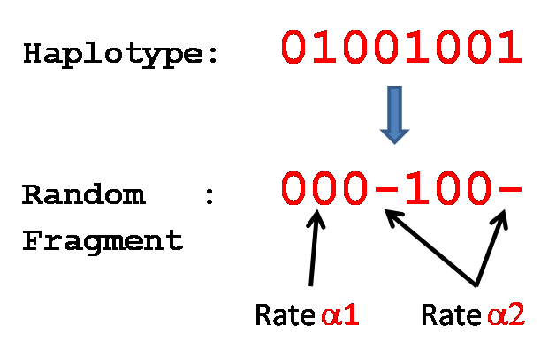
Haplotype Reconstruction Problem
Consider the following model parameters:
1) α1 , inconsistency rate
2) α2 , incompleteness rate
3) β , difference rate
A fragment is generated_{(α1, α2)} by
a Haplotype H if
mismatch/inconsistency errors happened with probability at most α1.
Holes happen with
probability at most α2.
Haplotype Reconstruction Problem:
Let α1, α2, and β be small positive constants.
Let H1 and H2 be any two length m haplotypes
Such that:
HAMM( H1, H2 )
m
≥
β
Input: n x m SNP matrix such that each row
Is generated_{(α1, α2)} by either H1 or H2.
Output: H1 and H2. (with high probability)

Slide 29
Outline
Background, Haplotypes
Problem Formulation
Algorithms
Empirical Data

Slide 30
Algorithm 1
010010-10-10101—
1—101-0—0--110--
--011-01001--010
010-1001-010-000
11----10101-101-
111—10-0--1110-1
--0110010-10-01-
-1111—100-111--1
Grab a random fragment X
GROUP1
GROUP2
010010-10-10101—

Slide 31
Algorithm 1
010010-10-10101—
1—101-0—0--110--
--011-01001--010
010-1001-010-000
11----10101-101-
111—10-0--1110-1
--0110010-10-01-
-1111—100-111--1
Grab a random fragment X
Compare each remaining
fragment Y to X:
- IF diff( Y, X ) < 2( α1 + ε )
THEN put Y in GROUP1
ELSE put Y in GROUP2
GROUP1
GROUP2
010010-10-10101—

Slide 32
Algorithm 1
010010-10-10101—
1—101-0—0--110--
--011-01001--010
010-1001-010-000
11----10101-101-
111—10-0--1110-1
--0110010-10-01-
-1111—100-111--1
Grab a random fragment X
Compare each remaining
fragment Y to X:
- IF diff( Y, X ) < 2( α1 + ε )
THEN put Y in GROUP1
ELSE put Y in GROUP2
For Example:
α1 = .03
ε = .04
2 or fewer mismatches, GROUP1
3 or more, GROUP2
GROUP1
GROUP2
010010-10-10101—
--011-01001—-010
010-1001-010-000
--0110010-10-01-
1—101-0—0--110--
11----10101-101-
111—10-0--1110-1
-1111—100-111--1

Slide 33
Algorithm 1
010010-10-10101—
1—101-0—0--110--
--011-01001--010
010-1001-010-000
11----10101-101-
111—10-0--1110-1
--0110010-10-01-
-1111—100-111--1
Grab a random fragment X
Compare each remaining
fragment Y to X:
- IF diff( Y, X ) < 2( α1 + ε )
THEN put Y in GROUP1
ELSE put Y in GROUP2
For Example:
α1 = .03
ε = .04
2 or fewer mismatches, GROUP1
3 or more, GROUP2
GROUP1
GROUP2
010010-10-10101—
--011-01001—-010
010-1001-010-000
--0110010-10-01-
1—101-0—0--110--
11----10101-101-
111—10-0--1110-1
-1111—100-111--1
Consensus Strings
0101100100101010
1110101000111011

Slide 34
Algorithm 1
Grab a random fragment X
Compare each remaining
fragment Y to X:
- IF diff( Y, X ) < 2( α1 + ε )
THEN put Y in GROUP1
ELSE put Y in GROUP2
GROUP1
GROUP2
010010-10-10101—
--011-01001—-010
010-1001-010-000
--0110010-10-01-
1—101-0—0--110--
11----10101-101-
111—10-0--1110-1
-1111—100-111--1
Consensus Strings
0101100100101010
1110101000111011
Theorem: n₁ and n₂ denote the number of fragments
generated from H1 and H2 respectively
If
4(α₁ + ε) < β
0 < 2α₁ + α₂ - ε < 1
Then the target haplotypes are reconstructed with probability at least
Pr ≥ 1 - 2ne^(-ε²m/3) – 2me ^(-ε²n₁/2) – 2me ^(-ε²n₂/2)
Example:
α₁ = 3% n = 50000
α₂ = 3% m = 50000
Β = 30% n₁ = 25000
ε = 0.044 n₂ = 25000
Pr[success] ≥ 0.999993817

Slide 35
Algorithm 1
Grab a random fragment X
Compare each remaining
fragment Y to X:
- IF diff( Y, X ) < 2( α1 + ε )
THEN put Y in GROUP1
ELSE put Y in GROUP2
GROUP1
GROUP2
010010-10-10101—
--011-01001—-010
010-1001-010-000
--0110010-10-01-
1—101-0—0--110--
11----10101-101-
111—10-0--1110-1
-1111—100-111--1
Consensus Strings
0101100100101010
1110101000111011
Downside:
Algorithm 1 needs to know the parameter α1

Slide 36
Algorithm 2
010010-10-10101—
1—101-0—0--110--
--011-01001--010
010-1001-010-000
11----10101-101-
111—10-0--1110-1
--0110010-10-01-
-1111—100-111--1
Pick 2 fragments at random
GROUP1
GROUP2
010010-10-10101—
010-1001-010-000

Slide 37
Algorithm 2
010010-10-10101—
1—101-0—0--110--
--011-01001--010
010-1001-010-000
11----10101-101-
111—10-0--1110-1
--0110010-10-01-
-1111—100-111--1
Partition each remaining
fragment to closest
representative fragment
GROUP1
GROUP2
010010-10-10101—
--011-01001—-010
11----10101-101-
111—10-0--1110-1
-1111—100-111--1
010-1001-010-000
1—101-0—0--110--
--0110010-10-01-

Slide 38
Algorithm 2
010010-10-10101—
1—101-0—0--110--
--011-01001--010
010-1001-010-000
11----10101-101-
111—10-0--1110-1
--0110010-10-01-
-1111—100-111--1
GROUP1
Can get a
Bad Partition
GROUP2
010010-10-10101—
--011-01001—-010
11----10101-101-
111—10-0--1110-1
-1111—100-111--1
010-1001-010-000
1—101-0—0--110--
--0110010-10-01-
So try again…

Slide 39
Algorithm 2
Repeatedly pick 2 random fragments, and partition.
010010-10-10101—
1—101-0—0--110--
--011-01001--010
010-1001-010-000
11----10101-101-
111—10-0--1110-1
--0110010-10-01-
-1111—100-111--1
GROUP1
GROUP2
010010-10-10101—
--011-01001—-010
11----10101-101-
111—10-0--1110-1
-1111—100-111--1
010-1001-010-000
1—101-0—0--110--
--0110010-10-01-

Slide 40
Algorithm 2
Repeatedly pick 2 random fragments, and partition.
- For each iteration, compute
MAX distance between representative fragment and any other fragment in the same group.
010010-10-10101—
1—101-0—0--110--
--011-01001--010
010-1001-010-000
11----10101-101-
111—10-0--1110-1
--0110010-10-01-
-1111—100-111--1
GROUP1
GROUP2
010010-10-10101—
--011-01001—-010
11----10101-101-
111—10-0--1110-1
-1111—100-111--1
010-1001-010-000
1—101-0—0--110--
--0110010-10-01-

Slide 41
Algorithm 2
Repeatedly pick 2 random fragments, and partition.
- For each iteration, compute
MAX distance between representative fragment and any other fragment in the same group.
-Repeat O(1) times, output
the best partition found over all iterations.
010010-10-10101—
1—101-0—0--110--
--011-01001--010
010-1001-010-000
11----10101-101-
111—10-0--1110-1
--0110010-10-01-
-1111—100-111--1
GROUP1
GROUP2
Achieves success with
high probability
Does not require prior
knowledge of model
parameters
010010-10-10101—
--011-01001—-010
11----10101-101-
111—10-0--1110-1
-1111—100-111--1
010-1001-010-000
1—101-0—0--110--
--0110010-10-01-

Slide 42
Algorithm 3
Repeatedly pick 2 random fragments, and partition.
- For each iteration, compute
MAX distance between representative fragment and any other fragment in the same group.
-Repeat O(1) times, output
the best partition found over all iterations.
010010-10-10101—
1—101-0—0--110--
--011-01001--010
010-1001-010-000
11----10101-101-
111—10-0--1110-1
--0110010-10-01-
-1111—100-111--1
Measure SUM of distances between representative fragment and ALL other fragments in the same group
-This achieves the best empirical results
GROUP1
GROUP2
Achieves success with
high probability
Does not require prior
knowledge of model
parameters
010010-10-10101—
--011-01001—-010
11----10101-101-
111—10-0--1110-1
-1111—100-111--1
010-1001-010-000
1—101-0—0--110--
--0110010-10-01-

Slide 43
Outline
Background, Haplotypes
Problem Formulation
Algorithms
Empirical Data

Slide 44
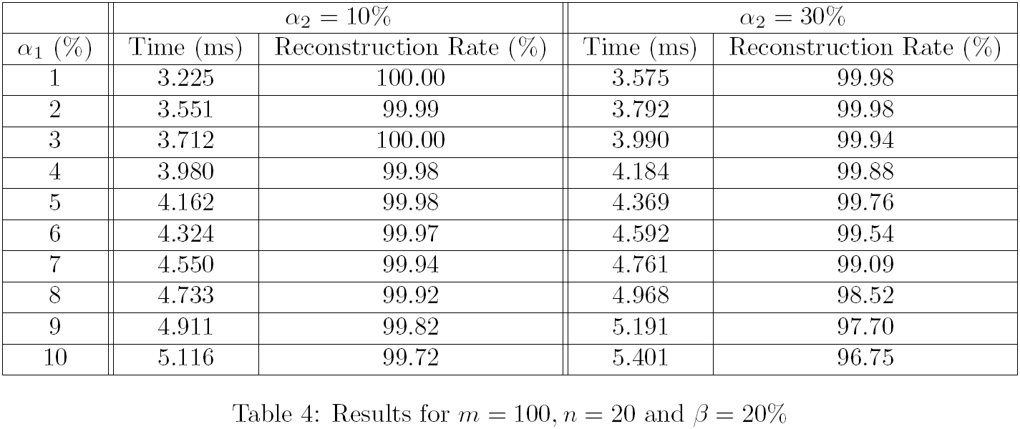
Empirical Tests
In experiments, Algorithm 3 gave the best performance:

Slide 45
Summary / Future Work
Summary
Provably good probabilistic algorithms for singular haplotype reconstruction.
Algorithms are fast: linear time
Good empirical performance on simulated data
Future Work
Consider model with short fragments
Test with real biological data
The software of our algorithms is available for public access and for real-time on-line demonstration at
http://fpsa.cs.uno.edu/HapRec/HapRec.html
Thank you for listening. Questions?

