Slide 1
Weak Cooperation in Tile Self-Assembly
Andrew Winslow, Tufts University

Slide 2
Strong Cooperation
𝜏 = 2
Notes:
Variety of proof-of-concept shapes possible. Nanoscale (applications to build things smaller than otherwise possible). DNA is information-rich (more varied behavior in self-assembly).

Slide 3
Strong Cooperation
𝜏 = 2
Notes:
Variety of proof-of-concept shapes possible. Nanoscale (applications to build things smaller than otherwise possible). DNA is information-rich (more varied behavior in self-assembly).

Slide 4
Strong Cooperation
𝜏 = 2
Notes:
Variety of proof-of-concept shapes possible. Nanoscale (applications to build things smaller than otherwise possible). DNA is information-rich (more varied behavior in self-assembly).

Slide 5
Strong Cooperation
𝜏 = 2
Notes:
Variety of proof-of-concept shapes possible. Nanoscale (applications to build things smaller than otherwise possible). DNA is information-rich (more varied behavior in self-assembly).

Slide 6
𝜏 = 2

Slide 7
𝜏 = 2

Slide 8
𝜏 = 2

Slide 9
𝜏 = 2

Slide 10
𝜏 = 2

Slide 11
𝜏 = 2

Slide 12
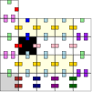
𝜏 = 2

Slide 13
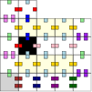
𝜏 = 2

Slide 14
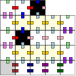
𝜏 = 2

Slide 15
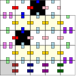
𝜏 = 2

Slide 16
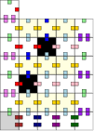
𝜏 = 2

Slide 17
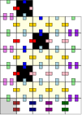
𝜏 = 2

Slide 18
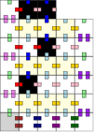
𝜏 = 2

Slide 19
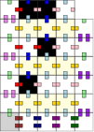
𝜏 = 2

Slide 20
𝜏 = 2

Slide 22
“write 1, move left, change to s1”

Slide 23
“write 1, move right, change to s1”
“write 1, move left, change to s1”

Slide 24
“write 0, move right, change to s0”
“write 1, move right, change to s1”
“write 1, move left, change to s1”

Slide 25
“write 0, move right, change to s0”
“write 0, move right, change to s0”
“write 1, move right, change to s1”
“write 1, move left, change to s1”

Slide 27
“write 1, move left, change to s1”

Slide 28
“write 1, move left, change to s1”

Slide 29
“write 1, move left, change to s1”

Slide 31
“write 1, move right, change to s1”

Slide 32
“write 1, move right, change to s1”

Slide 33
“write 1, move right, change to s1”

Slide 35
“write 0, move right, change to s0”

Slide 36
“write 0, move right, change to s0”

Slide 37
“write 0, move right, change to s0”

Slide 39
“write 0, move right, change to s0”

Slide 40
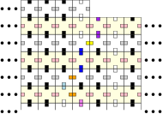
“write 0, move right, change to s0”

Slide 41
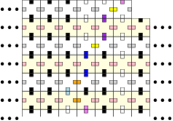
“write 0, move right, change to s0”

Slide 42
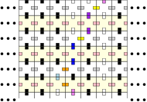

Slide 44
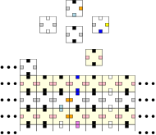
Strong Cooperation

Slide 45
Row direction, new head state.
Tape value, head state.

Slide 46
Computational Power
A “unit” of computation:
Read from two memory locations (#1, #2)
Compute simple function of values.
Store in third location. (#3)
In strong cooperation:
Location #1, #3: sequence of glues along growing path.
Location #2: exposed glue elsewhere. (Glue “cooperates”)

Slide 47
Computational Power
A “unit” of computation:
Read from two memory locations (#1, #2)
Compute simple function of values.
Store in third location. (#3)
In strong cooperation:
Location #1, #3: sequence of glues along growing path.
Location #2: exposed glue elsewhere. (Glue “cooperates”)

Slide 49
Computational Power
A “unit” of computation:
Read from two memory locations (#1, #2)
Compute simple function of values.
Store in third location. (#3)
In strong cooperation:
Location #1, #3: sequence of glues along growing path.
Location #2: exposed glue elsewhere. (Glue “cooperates”)

Slide 50
Figure of computation unit using strong cooperation.

Slide 51
Is a cooperating glue required to read?

Slide 52
Is a cooperating glue required to read?
No.

Slide 53
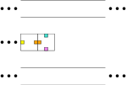

Slide 54
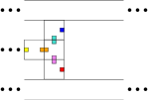

Slide 55
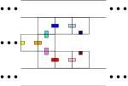

Slide 56
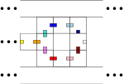
0

Slide 58
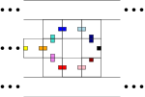
1

Slide 60
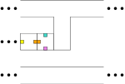
0

Slide 61
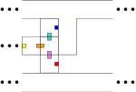
0

Slide 62
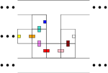
0
0

Slide 64
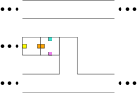
1

Slide 65
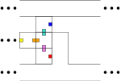
1

Slide 66
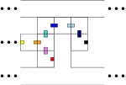
1
1

Slide 67
Weak Cooperation
Do not read/write memory in exposed glue.
Implement at temperature 1.

Slide 68
Weak Cooperation
Do not read/write memory in exposed glue.
Implement at temperature 1.
Planarity is the major barrier.
How to read and escape?

Slide 69
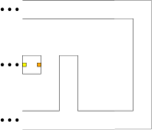

Slide 70
?

Slide 71
?

Slide 72
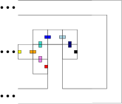

Slide 74
?

Slide 78
Weak Cooperation
Do not read/write memory in exposed glue.
Implement at temperature 1.
Planarity is the major barrier.
How to read and escape?
Change the model

Slide 79
Approach 1: Negative Glue
[Patitz, Schweller, Summers 2011]
Exposed glue does opposite of cooperate.
Still get AND-like dependence on exposed glue.
YES
YES
NO

Slide 80
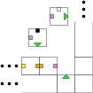
Approach 1: Negative Glue
[Patitz, Schweller, Summers 2011]
Exposed glue does opposite of cooperate.
Still get AND-like dependence on exposed glue.
0

Slide 81
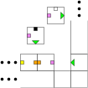
Approach 1: Negative Glue
[Patitz, Schweller, Summers 2011]
Exposed glue does opposite of cooperate.
Still get AND-like dependence on exposed glue.
1

Slide 82
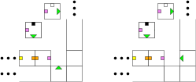
Approach 1: Negative Glue
[Patitz, Schweller, Summers 2011]
Exposed glue does opposite of cooperate.
Still get AND-like dependence on exposed glue.
0
1

Slide 83
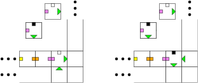
Approach 1: Negative Glue
[Patitz, Schweller, Summers 2011]
Exposed glue does opposite of cooperate.
Still get AND-like dependence on exposed glue.
0
1
0
1

Slide 84
Approach 2: 3D
[Cook, Fu, Schweller 2012]
Solve planarity problem directly: use third dimension.

Slide 85
Approach 2: 3D
[Cook, Fu, Schweller 2012]
Solve planarity problem directly: use third dimension.
?

Slide 86
Approach 2: 3D
[Cook, Fu, Schweller 2012]
Solve planarity problem directly: use third dimension.

Slide 87
Approach 2: 3D
[Cook, Fu, Schweller 2012]
Solve planarity problem directly: use third dimension.

Slide 88
Approach 2: 3D
[Cook, Fu, Schweller 2012]
Solve planarity problem directly: use third dimension.

Slide 89
Approach 2: 3D
[Cook, Fu, Schweller 2012]
Solve planarity problem directly: use third dimension.

Slide 90
Approach 3: Signal Tiles
[Padilla et al.], [Jonoska, Karpenko 2014]
Use signal tiles to send a message through the wall.

Slide 91
Approach 3: Signal Tiles
[Padilla et al.], [Jonoska, Karpenko 2014]
Use signal tiles to send a message through the wall.

Slide 92
Approach 3: Signal Tiles
[Padilla et al.], [Jonoska, Karpenko 2014]
Use signal tiles to send a message through the wall.

Slide 93
Approach 3: Signal Tiles
[Padilla et al.], [Jonoska, Karpenko 2014]
Use signal tiles to send a message through the wall.

Slide 94
Approach 3: Signal Tiles
[Padilla et al.], [Jonoska, Karpenko 2014]
Use signal tiles to send a message through the wall.

Slide 95
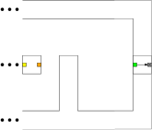
Approach 3: Signal Tiles
[Padilla et al.], [Jonoska, Karpenko 2014]
Use signal tiles to send a message through the wall.

Slide 96
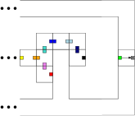
Approach 3: Signal Tiles
[Padilla et al.], [Jonoska, Karpenko 2014]
Use signal tiles to send a message through the wall.

Slide 97
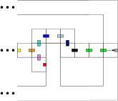
Approach 3: Signal Tiles
[Padilla et al.], [Jonoska, Karpenko 2014]
Use signal tiles to send a message through the wall.

Slide 98
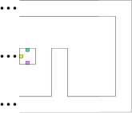
Approach 4: Polyomino Tiles
[Hendricks et al. 2014], [Demaine et al. 2015(?)]
Use a fat tile to avoid closing off region.

Slide 99
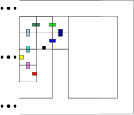
Approach 4: Polyomino Tiles
[Hendricks et al. 2014], [Demaine et al. 2015(?)]
Use a fat tile to avoid closing off region.

Slide 100
Approach 4: Polyomino Tiles
[Hendricks et al. 2014], [Demaine et al. 2015(?)]
Use a fat tile to avoid closing off region.

Slide 101
Approach 4: Polyomino Tiles
[Hendricks et al. 2014], [Demaine et al. 2015(?)]
Use a fat tile to avoid closing off region.

Slide 102
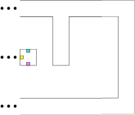
Approach 4: Polyomino Tiles
[Hendricks et al. 2014], [Demaine et al. 2015(?)]
Use a fat tile to avoid closing off region.

Slide 103
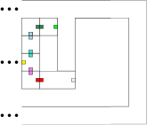
Approach 4: Polyomino Tiles
[Hendricks et al. 2014], [Demaine et al. 2015(?)]
Use a fat tile to avoid closing off region.

Slide 104
Approach 4: Polyomino Tiles
[Hendricks et al. 2014], [Demaine et al. 2015(?)]
Use a fat tile to avoid closing off region.

Slide 105
Approach 4: Polyomino Tiles
[Hendricks et al. 2014], [Demaine et al. 2015(?)]
Use a fat tile to avoid closing off region.
Harder: what if all tiles are fat?
Ongoing work…
Known: possible if tiles are n x m..

Slide 106
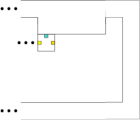
Approach 5: Probabilistic
[Cook, Fu, Schweller 2012]
Repeatedly “race” two options, read correctly w.h.p.
0

Slide 107
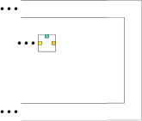
Approach 5: Probabilistic
[Cook, Fu, Schweller 2012]
Repeatedly “race” two options, read correctly w.h.p.
1

Slide 108
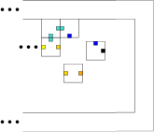
Approach 5: Probabilistic
[Cook, Fu, Schweller 2012]
Repeatedly “race” two options, read correctly w.h.p.
1

Slide 109
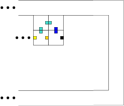
Approach 5: Probabilistic
[Cook, Fu, Schweller 2012]
Repeatedly “race” two options, read correctly w.h.p.
1
1
CORRECT

Slide 110
Approach 5: Probabilistic
[Cook, Fu, Schweller 2012]
Repeatedly “race” two options, read correctly w.h.p.
1

Slide 111
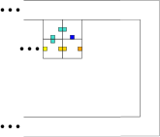
Approach 5: Probabilistic
[Cook, Fu, Schweller 2012]
Repeatedly “race” two options, read correctly w.h.p.
1
?

Slide 112
Approach 5: Probabilistic
[Cook, Fu, Schweller 2012]
Repeatedly “race” two options, read correctly w.h.p.
1
?
Less likely to be 1

Slide 113
Approach 5: Probabilistic
[Cook, Fu, Schweller 2012]
Repeatedly “race” two options, read correctly w.h.p.
1
?
Less likely to be 1

Slide 114
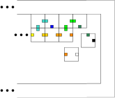
Approach 5: Probabilistic
[Cook, Fu, Schweller 2012]
Repeatedly “race” two options, read correctly w.h.p.
1
Less likely to be 1

Slide 115
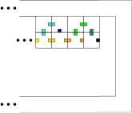
Approach 5: Probabilistic
[Cook, Fu, Schweller 2012]
Repeatedly “race” two options, read correctly w.h.p.
1
1
CORRECT

Slide 116
Approach 5: Probabilistic
[Cook, Fu, Schweller 2012]
Repeatedly “race” two options, read correctly w.h.p.
1
Less likely to be 1

Slide 117
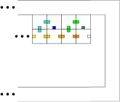
Approach 5: Probabilistic
[Cook, Fu, Schweller 2012]
Repeatedly “race” two options, read correctly w.h.p.
1
?
Less likely to be 1
Less likely to be 1

Slide 118
Approach 5: Probabilistic
[Cook, Fu, Schweller 2012]
Repeatedly “race” two options, read correctly w.h.p.
1
?
Even less likely to be 1

Slide 119
Approach 5: Probabilistic
[Cook, Fu, Schweller 2012]
Repeatedly “race” two options, read correctly w.h.p.
1
0
Even less likely to be 1
INCORRECT

Slide 120
Approach 5: Probabilistic
[Cook, Fu, Schweller 2012]
Repeatedly “race” two options, read correctly w.h.p.
0

Slide 121
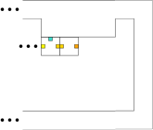
Approach 5: Probabilistic
[Cook, Fu, Schweller 2012]
Repeatedly “race” two options, read correctly w.h.p.
0
?
Less likely to be 1

Slide 122
Approach 5: Probabilistic
[Cook, Fu, Schweller 2012]
Repeatedly “race” two options, read correctly w.h.p.
0
?
Less likely to be 1

Slide 123
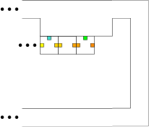
Approach 5: Probabilistic
[Cook, Fu, Schweller 2012]
Repeatedly “race” two options, read correctly w.h.p.
0
Less likely to be 1

Slide 124
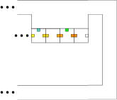
Approach 5: Probabilistic
[Cook, Fu, Schweller 2012]
Repeatedly “race” two options, read correctly w.h.p.
0
?
Less likely to be 1
Less likely to be 1

Slide 125
Approach 5: Probabilistic
[Cook, Fu, Schweller 2012]
Repeatedly “race” two options, read correctly w.h.p.
0
?
Even less likely to be 1

Slide 126
Approach 5: Probabilistic
[Cook, Fu, Schweller 2012]
Repeatedly “race” two options, read correctly w.h.p.
0
0
Even less likely to be 1
CORRECT

Slide 127
Approach 5: Probabilistic
[Cook, Fu, Schweller 2012]
Repeatedly “race” two options, read correctly w.h.p.
Errors are exclusively “was 1, said it was 0”
Occur with probability 1-c^{(# tries)}.
One-sided.

Slide 128
Conclusions
Many ways to use weak cooperation to perform basic steps of computation in tile assembly.
Universal computation in tile assembly possible at temperature 1 provided some modification is ok.
Open: is modification necessary?

Slide 129
Computation vs. Behavior
Computational power isn’t the whole story of tiles.
Strong cooperation also allows synchronization: wait until tile appears at location.
Strong cooperation is stronger than weak cooperation for some definition of “strength”.

